Slide 1
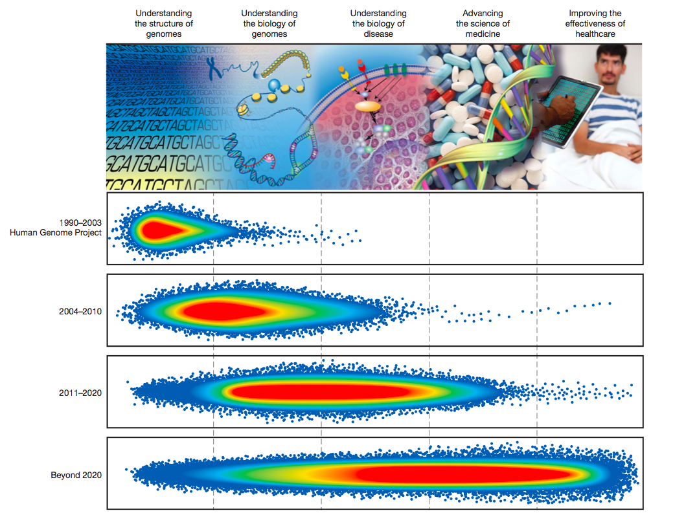
Motivation and Inspiration
NHGI Strategic Plan - 2011
How are we going to do this?
What is actually going on in the field?
What role should NIH/NHGRI play to support and accelerate progress?
Green ED, Guyer MS. Nature 2011; 470:204-13.

Slide 2
Genomic Medicine Institutes Colloquium
June 29, 2011, Chicago
MCW
Mt Sinai
Marshfield Cliniic
Northwestern
Loyola
Cleveland Clinic
UCSD
Morehouse
Duke
Maryland
Intermountain Healthcare
UAB
Geisinger
Baylor
OSU
Mayo Clinic
Partners Healthcare
U Chicago
Penn
St Judes
Vanderbilt
Johns Hopkins
Washington
NHGRI
NCI
NIMH
NINDS
NHLBI
~ 40 Attendees

Slide 3
Tasks
Identify areas of active translational and implementation research across the various groups and determine potential commonalities and uniqueness
Define demonstration projects in genomic translation ready for investigation now or in the near future and what is needed to actualize them
Stimulate development of a consortium for conducting genomic translational research

Slide 4
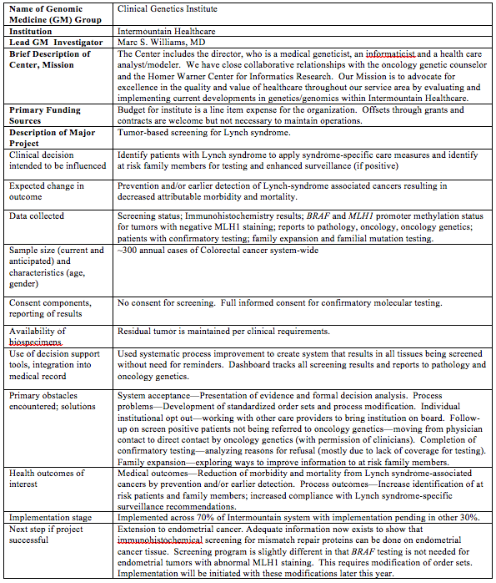

Slide 5
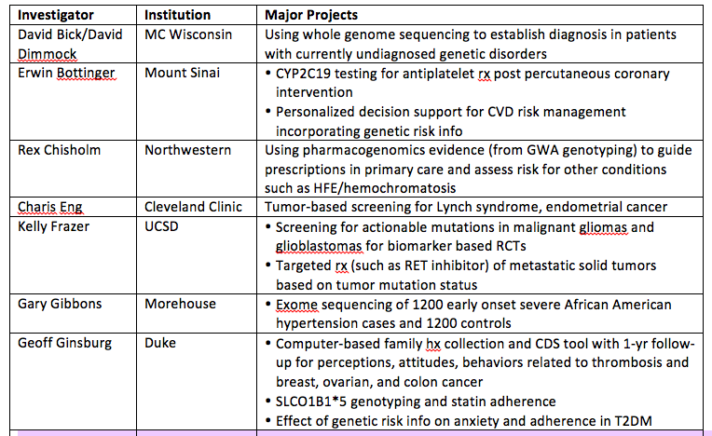

Slide 6
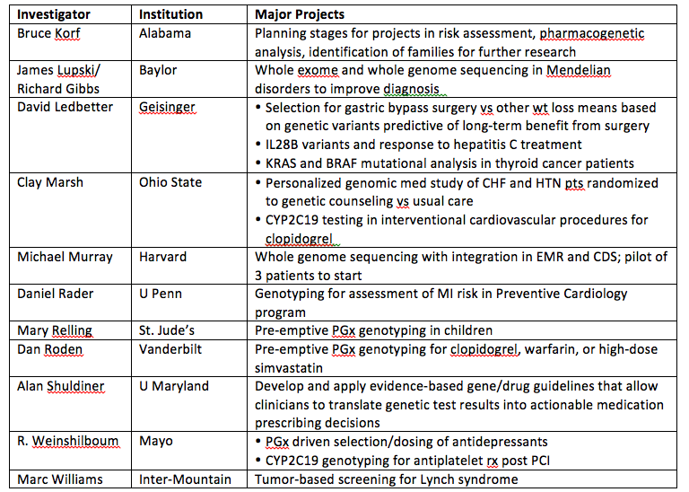

Slide 7
Another Set of Questions
What are the barriers at your institution to clinical adoption of genomics in medicine?
What are the solutions you have been able to achieve and how?
What role can NHGRI play to facilitate translation and adoption of genomics into medicine
  what infrastructure should NHGRI support?
  what research programs should NHGRI pursue?

Slide 8
Barriers -1
Lack of evidence for benefit/value
Institution and physician acceptance
Education of patients, physicians, public
Availability of testing, licensure, CLIA certification
EMR integration of genomic results, custom reporting tools and decision support software
Optimizing turnaround time

Slide 9
Barriers - 2
Need for genetic counseling
Consent
Improving information for at-risk family members
Sample availability and biobanking
Recruitment for genetic studies
Logistics of follow-up, loss to follow-up
Research funding and reimbursement
How do we know a genetic signal applies to our population?

Slide 10

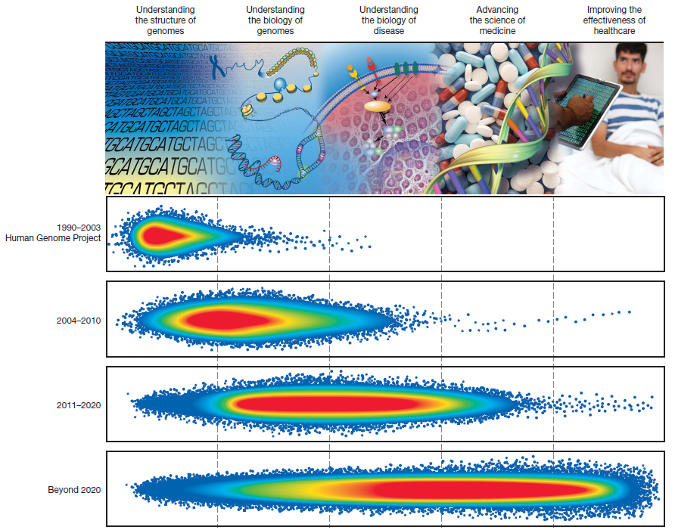
Keeping Our Eye on the Ball…
Green ED, Guyer MS. Nature 2011; 470:204-13.

Slide 11
Possible Outcomes of Chicago Meeting
Enhanced appreciation and understanding of ongoing genomic medicine efforts NIH-wide
Writing groups
  Perspectives papers
  Best practice guidelines
Planning groups for workshops or conferences
Loose confederation or consortium for collaborative studies
Best practices

Slide 12
Leveraging Existing Efforts
Over 20 genomic medicine centers at varying stages of implementation
Supported through multiple NIH and institutional mechanisms
Numerous similar and overlapping efforts that would benefit from collaboration
Numerous shared needs
Would benefit from periodic interactions and degree of coordination, consensus building
Critical to facilitate but not impede

Slide 13
Proposed Goals of Genomic Medicine Effort
Identify research directions and priorities
Promote collaboration among existing groups
Stimulate investigator-initiated efforts and issue funding solicitations as needed
Learn more about genomic medicine centers at NHGRI/NIH staff level by visiting
Establish Genomic Medicine Working Group as subcommittee of Council
  Rotating membership
  At least one Council member
  Report back to Council regularly

Slide 14
Genomic Medicine Working Group
Possible Tasks
Identify topics for subsequent meetings of genomic medicine groups, plan those meetings
Identify topics for separate working groups or workshops
Monitor production of white papers, assist and/or prod as needed
Review progress in given area for readiness for exploration in subsequent working groups

Slide 15
Genomic Medicine Working Group
Possible Tasks (cont)
Review progress overall in genomic medicine implementation and identify gaps, opportunities
Identify related efforts and integrate as appropriate
  ClinVar and actionable variants
  eMERGE and clinical decision support, pilot implementation studies
  Clinical Sequencing Exploratory program
  Trans-NIH dissemination network
  Clinical Translational Science Awards

Slide 16
Current/Planned Working Groups and Workshops
Databases and actionable variants
Dec 1-2, 2011
Collaborative demonstration projects
Dec 5-6, 2011 (this meeting!)
Standardization, quality control of clinical genomic testing and reporting
  May 3-4, 2012
Evidence development (discovery, validation) for actionable variants
  Sep 2012?

Slide 17
Potential Working Groups and Workshops: Infrastructure and Research Needs
Evidence development for effectiveness of genomic medicine
Tool development for genomic medicine (CDS, clinical algorithms)
Policy needs (consent, CLIA, reimbursement)
Education, training, user support

Slide 18

Avoiding Meeting Hell
Larson, G. The Complete Far Side. 2003.

Slide 19
Proposed Genomic Medicine II (Fall 2011)
Broaden involvement of relevant groups
Identify low-cost pilot projects to build on similar efforts across sites
Convene working groups and workshop planning to address obst/opport from GM I
Identify additional groups to participate
Determine appropriate next steps for group as whole (meetings, white papers?)

